Slide 1
Improve PSNR of Transmitted Images
Peng Xie
using deep learning to increase image resolution
Original Images
Deep Learning
Trained Network
Improved
Image
Estimated residual image

Slide 2
Train Network
41 individual layers define the network, these layers include:
imageInputLayer - the image input layer
convolution2dLayer - 2D Convolutional Layer for Convolutional Neural Networks
reluLayer - Rectified Linear Unit (ReLU) layer
regressionLayer - the regression output layer of the neural network

Slide 3
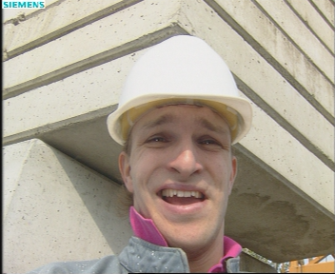
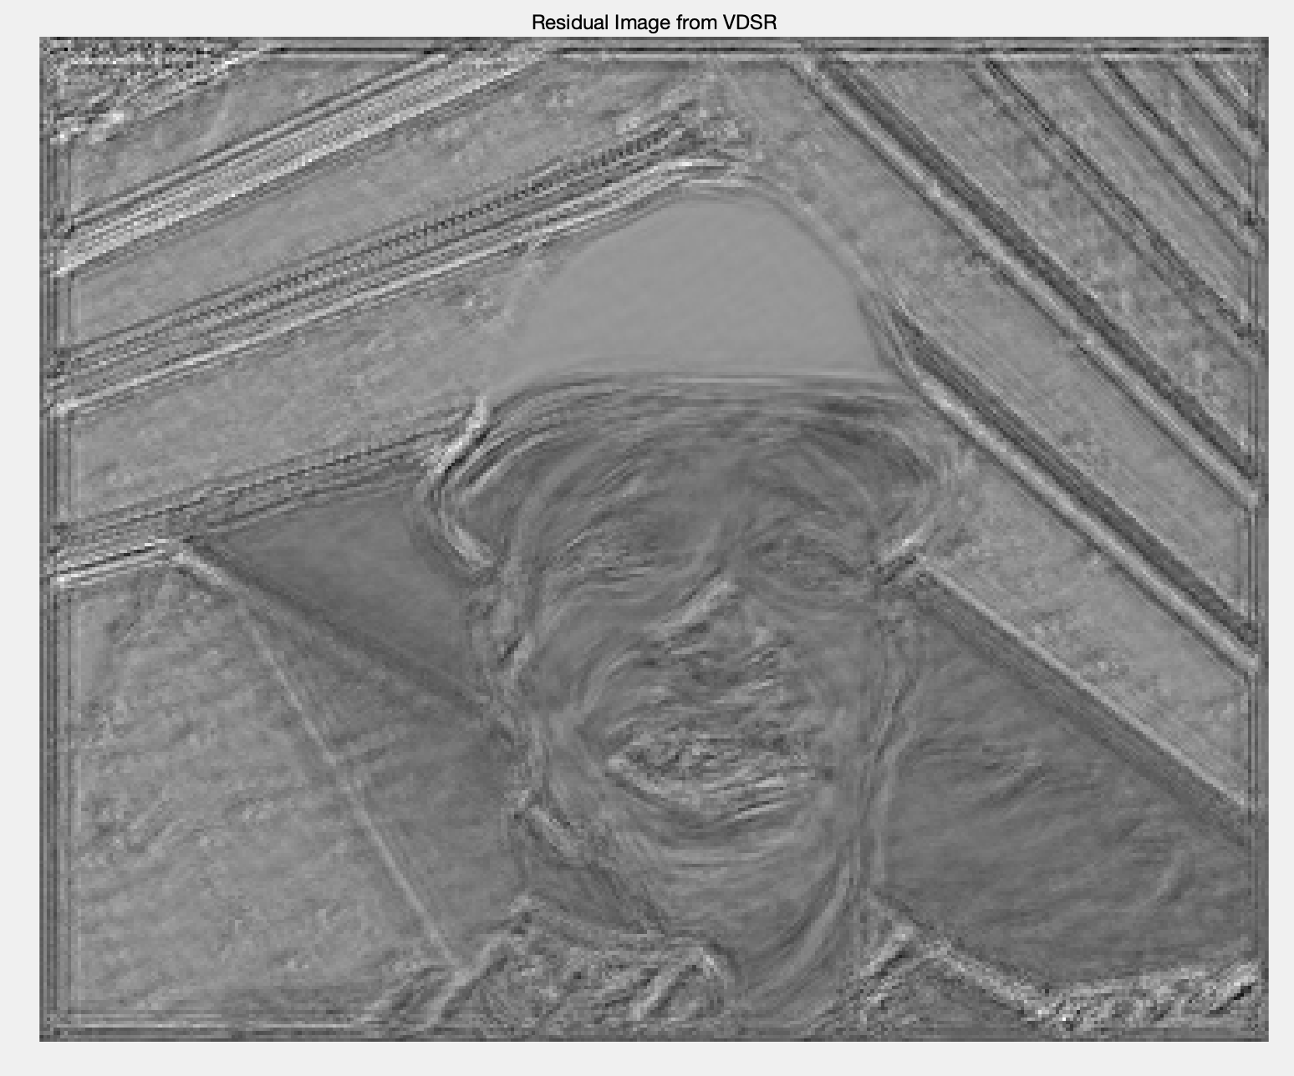
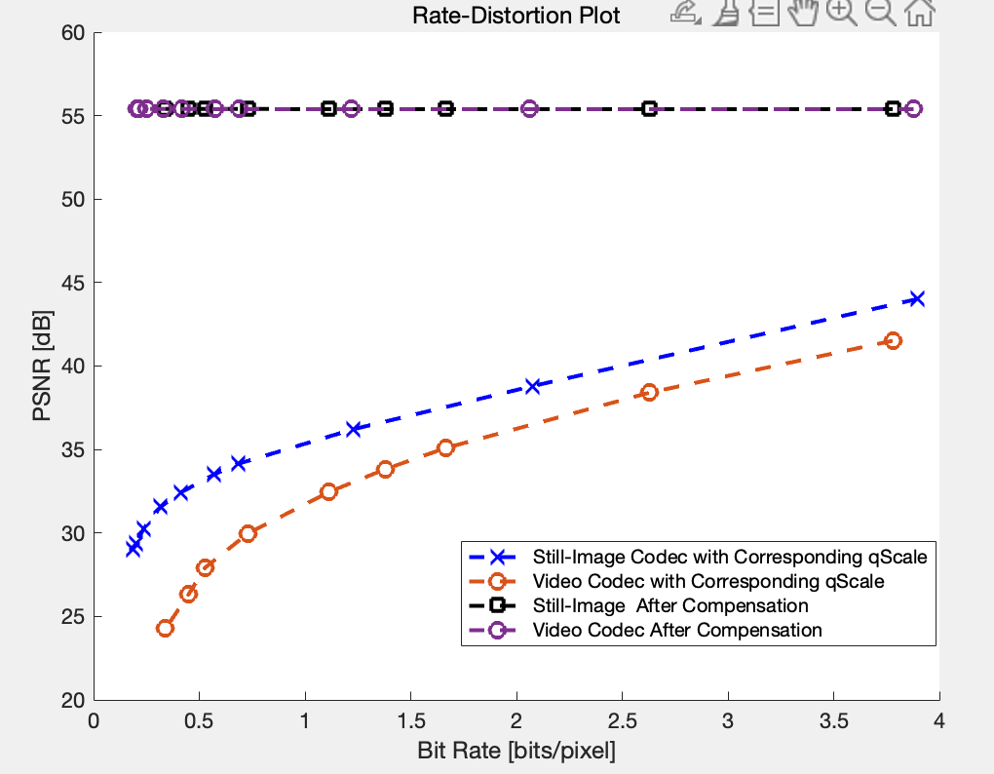
Estimated residual image
Only the luminance channel is processed
Add the compensated image to the transferred image to get the final image

